Slide 1
Data Gathering & Analysis
Viswanathan Hariharan

Slide 2
Contents
Principles of data gathering
Objectives of data gathering
Impact of data gathering on the organization
Data gathering process
Data Analysis
Page 2

Slide 3
Managed Process (Level 4)
At this level the organization would have a firm foundation for introducing measurements and statistical management
Page <number>

Slide 4
Data gathering & Analysis
Page <number>

Slide 5
Principles of Data gathering & Analysis
Data gathering is gathered in accordance with specific objectives and a plan
The choice of data gathered is based on a model or hypothesis about the process being examined
The data gathering process must consider the impact of data gathering on the entire organization
The data gathering plan must have management support
Page <number>

Slide 6
Objectives of data gathering
There can be different objectives:
Understanding: Data can be gathered to learn about an item or a process such as effort needed to design software or defect injection at different stages in the process
Evaluation: Data can be gathered to evaluate the quality of a product to see if it meets the acceptance criteria
Control: Data can be gathered to control some activity. For example, if the effort to develop a module is unduly large, it can indicate some issue. The Project manager can then investigate the matter and take necessary action
Prediction: Data can be used to develop trend indicators such as rate of reported defects per month after release
Page <number>

Slide 7
Data gathering models
It is easy to define what data needs to be gathered if we know what model of software development we are using
For example in an iterative software development model, we may be interested to know the size of software being developed in each iteration and the trend of defects identified in each iteration
Page <number>

Slide 8
Impact of data gathering on the organization
Impact on quality of data
If software measurements are used to evaluate performance of people, then people will try to make the numbers look good
So if we want correct data gathering we should emphasize & ensure that software data is not used to evaluate people
Page <number>

Slide 9
Impact of data gathering on the organization
Data gathering is tedious
Unless people are convinced that data is important, they will not do it or will not be careful when they do.
When data gathering is not done at the time an activity is performed, the data is likely to be inaccurate (ex. Entering time sheet at the end of the week, instead of daily)
Hence we need to show how data gathering helps the professionals and share results with them
  Ex. Project managers will appreciate data about effort per phase that will help them in estimation
  Ex. Programmers will appreciate data about defects that helps in improving quality
Page <number>

Slide 10
Impact of data gathering on the organization
For reasons of objectivity and cost, it is important to automate as much of data gathering as possible
Ex. Gathering data about program size, complexity, etc.
Page <number>

Slide 11
Management support
Similar to any other investment, senior management support is essential
Once useful results are produced, project managers will generally be more willing to support data gathering work
Page <number>

Slide 12
Data gathering process
It is expensive
So data gathering should be carefully planned & managed
  We should not gather data that is not necessary (that does not have a clearly defined purpose)
  It must be validated to ensure its accuracy
Data must be retained by someone who owns & maintains the process database
Page <number>

Slide 13
Data validation
Basili found that as much as 50% of raw data about defects is incorrect
Similarly recording of elapse time has been found to be inaccurate
How can be ensure accuracy?
  Train people
  Do spot checks
  Define clearly the meaning of data
Page <number>

Slide 14
Software measures
Categories of software measures
  Size – LoC – with comments, without comments, with data definitions, etc.
  Effort – Person months – excluding meeting time
  Time – elapse time
  Defects – Severity, where found (module), when found (phase), when injected, how caused etc.
Page <number>

Slide 15
Defect classification
  Here are some important classification of defects
  Severity – Sev 1, Sev 2, Sev 3
  Where found – In which module
  When found (phase) – Requirement gathering, design, Coding, Integration test, System test
  When injected (phase during which the defect got introduced)
  How caused – Logical error, data definition error, interface error, etc.
Page <number>

Slide 16
Statistical analysis & control charts
Statistical analysis helps in identifying trouble spots
  Modules with high error density
  Module with low time spent in inspection
Example of analysis:
  Testing efficiency = 1 – (# Defects found in System test / Total # of defects found across all phases)
  Defect density at different stages (Defects per FP). Some organizations measure defect density in system testing in terms of defects per person month effort spent in software development
  Test cases per FP (indicates sufficiency of test cases)
  Distribution of defects across modules
Page <number>

Slide 17
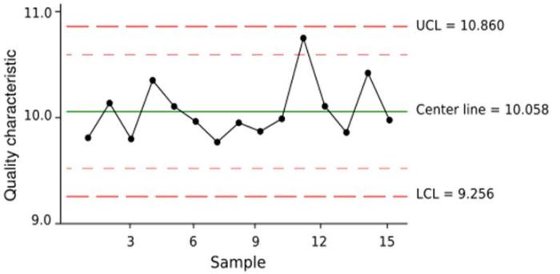
Control charts
All these data can be monitored using control charts
Any data point lying outside control limits (UCL, LCL) can be taken up for investigation
Pre-requisite for using control charts: Large amount of data should have been gathered across projects to arrive at the UCL & LCL
Page <number>

Slide 18
Managing software quality
Managing quality is like managing a project
We need to have a goal – a challenging goal, yet realistic – that motivates the employees
  Ex. Defect density of less than 1 per 1000 FP, schedule variance < 10%
Create a plan of actions to achieve the goal such as:
  Inspections
  Use of tools to improve productivity & quality
  Testing activities such as Integration testing, Performance testing, etc.
Monitor actions and address issues if any
Take improvement actions if goals are not met. Actions such as
  Improve code inspection coverage from 40% to 60%
  Increase inspection of code changes from 60% to 80%
Page <number>

Slide 19
Questions & Homework
What challenges does your organization face in gathering data?
What steps would you suggest to address these challenges?
Page <number>

Slide 20
Appendix
Page <number>

Slide 21
6 Sigma quality = 3.4 defects per 1 million opportunities
ie 99.99966% defect free
Page <number>

